Slide 1
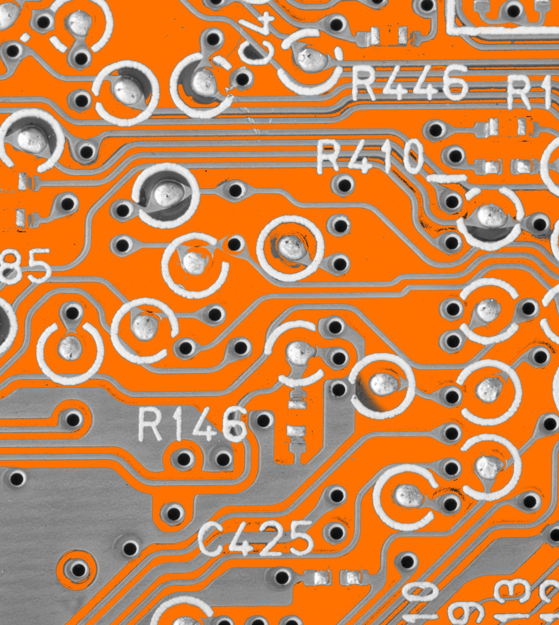

THE DIODE REGULATOR CIRCUIT
What is it and how does it work?
Notes:
The diode voltage regulator is a simple circuit used to generate voltages that are independent of their input voltage and are constant regardless of load. In this short video I will explain how diodes function and the basic operating principles of both diodes and diode voltage regulators.

Slide 2
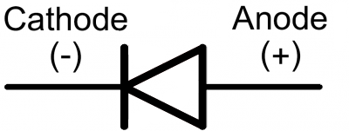
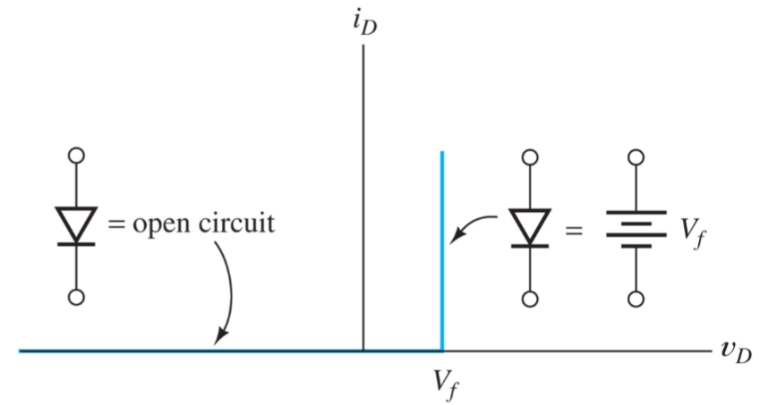
Diodes – Constant Voltage Drop Model
Allows current to flow in only one direction. From anode to cathode.
An ideal diode has zero voltage drop, allowing current only for V > 0.
We assume a voltage drop of 0.7V (Vf) to account for the non-linear properties of real diodes
Notes:
Diodes are a non-linear device, which unlike resistors, cannot be represented easily or accurately by a linear relationship. An ideal diode allows current to flow from anode to cathode only, and blocks any current from flowing the opposite way.

Slide 3
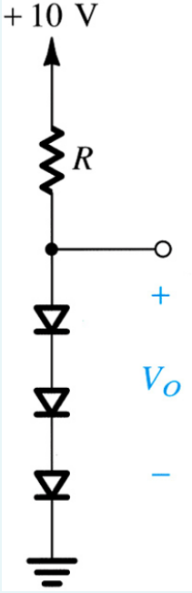
The Diode Voltage Regulator
Uses diodes to regulate voltage.
Drops a fixed voltage (0.7V) across the load, which is independent of input voltage.
This means our output voltage is independent of input voltage.
Notes:
We can use the voltage dropped across each diode to create an output voltage that’s a multiple of 0.7V. Since our 0.7 voltage drop model assumes a constant drop, the voltage generated is independent from both the input voltage and the value of R. This allows us to create specific voltages very easily.

Slide 4
Diode Voltage Regulator – Applications
We can use a voltage regulator to create specific voltages independent of input voltage.
This means our voltage across any given series of diodes remains constant regardless of load.
In this example Vo would be equal to 2.1V (0.7V*3). We can add more diodes to create voltages that are multiples of 0.7V.
Notes:
We can use voltage regulators to generate voltages that are independent of both input voltage and the value of R. But our output voltage also has the benefit of remaining constant regardless of the load attached. Our current may change depending on the load attached, but the voltage across the given diodes will always remain constant. In the example shown, our output voltage Vo is equal to 2.1V, which is just 0.7V multiplied by the number of diodes. So long as our input voltage is high enough to provide a forward bias to the number of diodes being used, we can generate independent voltages that are multiples of 0.7 easily.

